Slide 1
Date: 28 October 2025

Slide 2
Weekly Presentation : Rotor Bearing System
Week number: 05
Date: 28/10/2025
Supervisor: Prof. Peter Quell
Group members: Divyesh Mistry, Venkata Sreekanth .K , Sreehari Padachery, Jill Sadariya
Presenter : Sreehari Padachery

Slide 3
Agenda
Task of the week.
Flowchart: Main Shaft and Bearing Sizing Model.
Load Equilibrium in a 3-Point Suspension System.
Reference : SKF Spherical Roller Bearing (Cylindrical Bore).
Bolted Flange Connection between Rotor Shaft and Rotor Hub.
Bibliography.

Slide 4
1. Task of the week
Analyzed Force-Momentum diagram of current rotor bearing system.
Studied Rotor Shaft calculation and Solution from previous year projects.
We conducted a meeting with the system integrator and the rotor hub team to decide the flange dimensions.

Slide 5
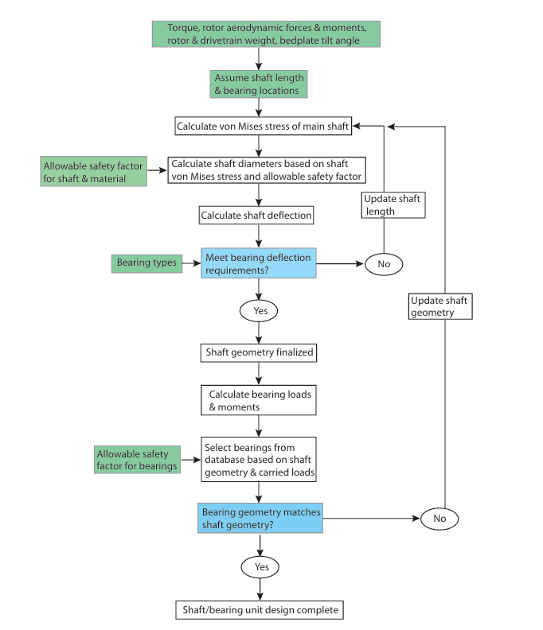
Flowchart: Main Shaft and Bearing Sizing Model
Source : NREL

Slide 6
Load Equilibrium in a 3-Point Suspension System
F_{ZR}​
F_{ZA}​
F_{S}s
F_{ZB}​
F_{G} s
F_{YR}​
F_{YA}​
F_{YB}​
M_{ZR}​
M_{YR}​
F_{XR}​
F_{XA}
Shaft C.G
Gear Box
M_{XR}​
Bearing A
Bearing B
L₁
L₂
L_{S}
L_{G}

Slide 7
Load Equilibrium in a 3-Point Suspension System
Calculation of Bearing Reaction Forces
F_{S} :Shaft gravitational force.
F_{G} : Gearbox gravitational force.
F_{A} : Radial Forces in (Y, Z) direction for Bearing A
F_{XR}​ : Force in X-direction at the hub
F_{YR} : Force in Y-direction at the hub
F_{ZR} : Force in Z-direction at the hub
M_{XR} : Moment in X-direction at hub
M_{YR} : Moment in Y-direction at hub
M_{ZR} : Moment in Z-direction at hub
Equilibrium of Forces at Bearing (B):
𝑭𝑩_{𝑿} = 0
∑𝑭_{𝒀}(𝐵) = 𝐹_{𝑌𝑅}+𝐹_{𝐴𝑌}+𝐹_{𝐵𝑌} =0
𝑭_{𝑩𝒀}= −𝐹_{𝑌𝑅}−𝐹_{𝐴𝑌}
∑𝑭_{𝒁}(𝑩)=𝐹_{𝑍𝑅}+𝐹_{𝐴𝑍}+𝐹_{𝐵𝑍}−𝐹_{𝑠}−𝐹_{𝑔}=0
𝑭_{𝑩𝒁}= −𝐹_{𝑍𝑅}−𝐹_{𝐴𝑍}+𝐹_{𝑠}+𝐹_{𝑔}

Slide 8


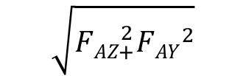
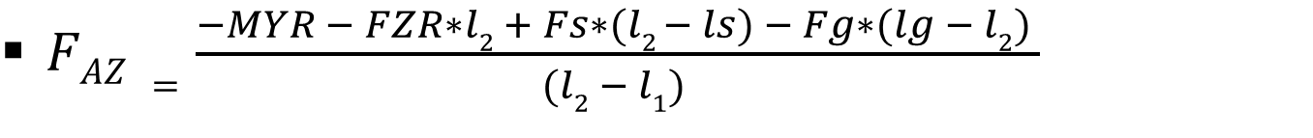
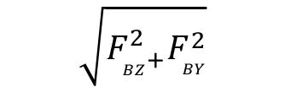
Equilibrium of Moments at Bearing (B):
∑𝐌_{𝐙}(𝑩)=M_{ZR}−𝐹_{𝑌𝑅}∗l₂−𝐹_{𝐴𝑌}∗(l₂−l₁)=0
$\text{F}\text{AY} \text{=}\frac{\text{M}\text{ZR}\text{−}\text{FYR}\text{∗}\text{l}\text{2}}{\text{(}\text{l}\text{2}\text{−}\text{l}\text{1}\text{)}}$
𝑭_{𝑩𝒀}= −𝐹_{𝑌𝑅}− $\frac{\text{M}\text{ZR}\text{−}\text{FYR}\text{∗}\text{l}\text{2}}{\text{(}\text{l}\text{2}\text{−}\text{l}\text{1}\text{)}}$
∑𝐌_{𝐘}(𝑩)=M_{YR}+𝐹_{𝑍𝑅}∗l2+𝐹_{𝐴𝑍}∗(l₂−l₁)−𝐹_{𝑠}*(l₂−l_{S})+𝐹_{𝑔}∗(l_{g}−l₂)=0
$FAZ =\frac{−MYR − FZR∗l2 + Fs∗(l2 − ls) − Fg∗(lg − l2) }{(l2 − l1) }$
$$\sqrt{{FAZ}_{+}^{2}{FAY}^{2}}$$
$$\sqrt{F_{BZ+}^{2}F_{BY}^{2}}$$
F_{Aresult}=
F_{Bresult}=

Slide 9
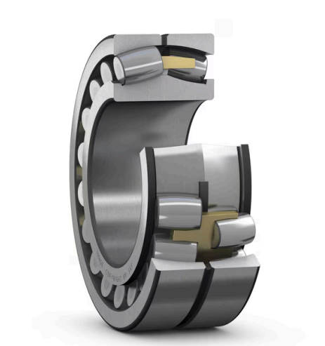
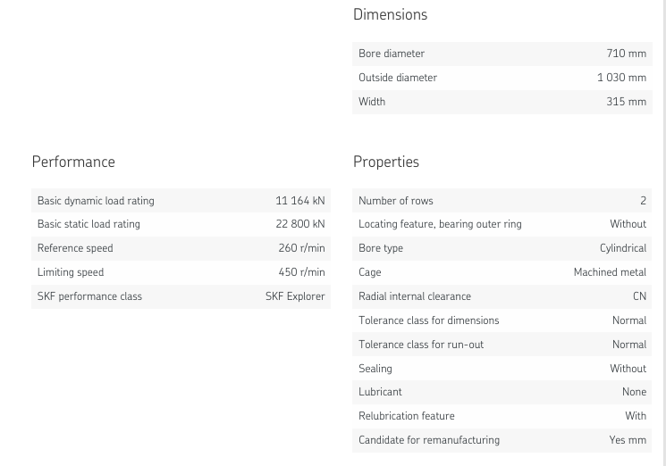
Reference : SKF Spherical Roller Bearing (Cylindrical Bore)
Model: 240/710 ECA/W33
Source :SKF

Slide 10

Spherical Journal Bearing
No response has been received from Renk so far.

Slide 11
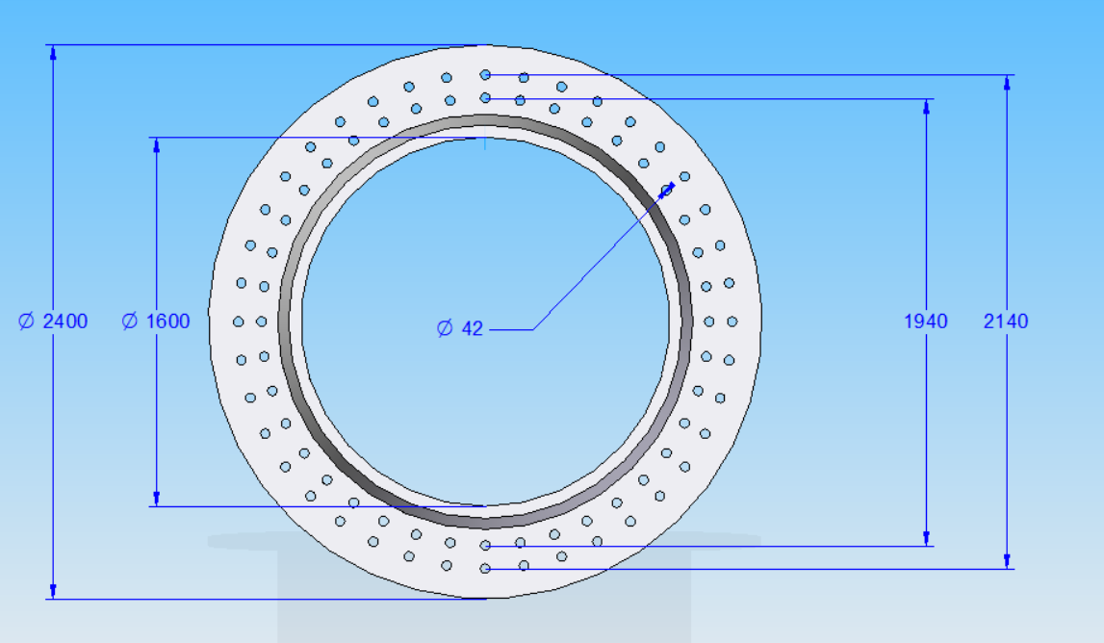
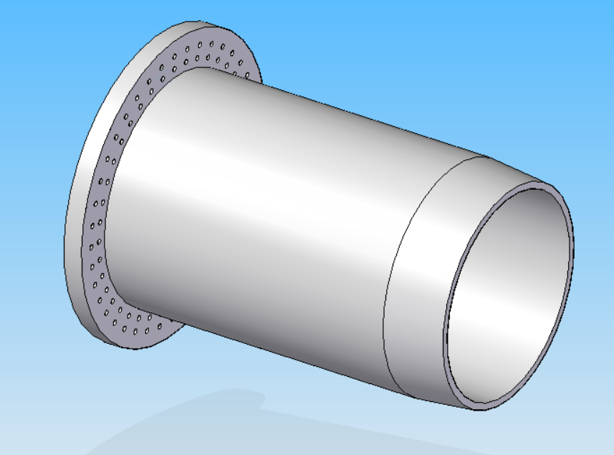
Bolted Flange Connection between Rotor Shaft and Rotor Hub
Flange thickness (t) = 150mm
All dimensions are in mml

Slide 12
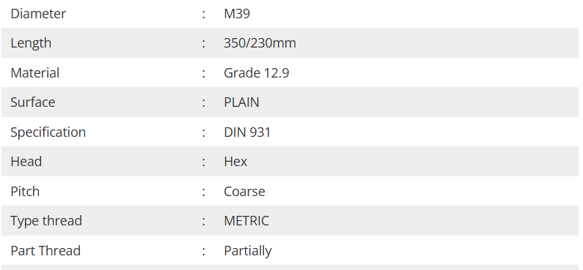
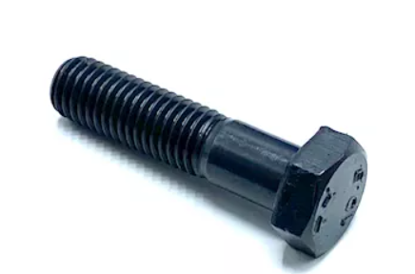
Bolted Flange Connection between Rotor Shaft and Rotor Hub
We conducted a meeting with the system integrator and the rotor hub team to decide the flange dimensions. We are scaling the design based on “Shakti.”
Optimus | Shakti | Syria
Rotor shaft diameter | 1800mm | 1600mm
Distance between Outer Flange bolt holes | 2340mm | 2140mm
Dia Inner Flange bolt holes | 2140mm | 1940mm
Bolt
Hex Head Bolt ,M39 × 350 mm
Source :ARAMFIX

Slide 13
Bibliography – Rotor Bearing System
Guo, Y., Parsons, T., King, R., Dykes, K., & Veers, P. (2015). An analytical formulation for sizing and estimating the dimensions and weight of wind turbine hub and drivetrain components (NREL/TP-5000-63008). National Renewable Energy Laboratory (NREL). Retrieved October 25, 2025, from https://www.nrel.gov/docs/fy15osti/63008.pdf
SKF. (n.d.). Spherical Roller Bearing 240/710 ECA/W33. SKF. Retrieved October 25, 2025, from https://www.skf.com/ch/de/products/rolling-bearings/roller-bearings/spherical-roller-bearings/productid-240%2F710%20ECA%2FW33 (accessed : 26/10/2025)
Aramfix. (n.d.). ISO 4014 Hex Bolt M42×350 mm Grade 10.9 Plain Metric (Partially Threaded). Aramfix. Retrieved October 27, 2025, from https://www.aramfix.com/product/iso-4014-hex-bolt-m42x350mm-grade-10-9-plain-metric-partially-hex-2-pcs-box (accessed : 26/10/2025)
Optimus Shakti

